Slide 1


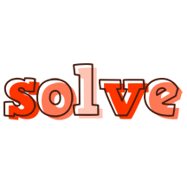






STEP 1
Go to textgiraffe to create your headings. Copy & paste them into each box.
STEP 5
Share this slide in present mode during a video call; give students choices for an activity. After 5 minutes, use the Random Name Picker from Classtools.net to choose students to share their answers / drawings / photos before class begins.
1
2
3
4
5
STEP 2
Add textboxes to each of the columns. Add your content.
Can you collect the following items in your house?
How many valentines were given out in class? There were more than 40 but less than 60. The sum of the digits is 8. It is an odd number.
Make a list of these Valentine’s Day things that begin with the letter V.
Draw a rose.
Draw a teddy bear.
Draw a candy heart.
Draw the word “LOVE.”
STEP 3
Download the Slides Timer Chrome extension & watch this video to learn how to add a countdown timer to your slides.
Mute your mic, please!
flower
candy
something pink
cupid
heart
flower
candy
thing you love
something pink
love song
STEP 4
Search for a video in YouTube and insert your own video. Go to Format Options and set the video to “autoplay.”
<<5:00->>
Notes:
Template from Canva {Tiny Multi-Color Hearts Valentine's Card}
Brain Teaser ideas from Games4Learning {Answer = 53!}
Video from TAZ Kids Fitness

Slide 2
1
2
3
4
5
text
text
text
text
Mute your mic, please!
text
text
<<5:00->>
Notes:
If you don’t like the first slide and want to customize one for your students, here’s an extra slide!

Slide 3
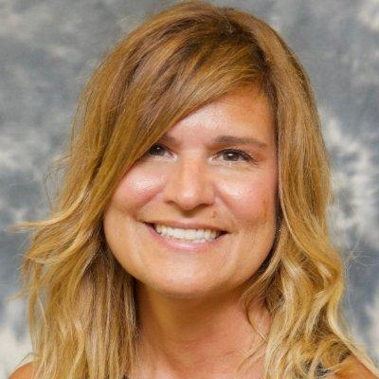

Stephanie DeMichele
Digital Learning Designer + Instructional Coach
Slayer of #Edtech Fears + Creator of #DigitalDoOvers
SHARING IS CARING
Please customize this template, but please also give credit to the original creator (and to those who inspired her!) when doing so and when posting to social media. In others words, make sure everyone gets credit for building upon the ideas of others!
I ❤️ WHAT I DO
I'm often asked why I don't charge for my work. Honestly, I do what I do because I'm a happy creator and sharer. A grateful teacher offered to Buy Me a Coffee once, and so, while I don't require payment--I'm always up for supporting my caffeine habit! (But only if you want to!)
#DistanceLearning is about #Flexibility | #StudentAgency | #Collaboration | #Creativity

